Slide 1
movements and groovements
RAY LC

Slide 2
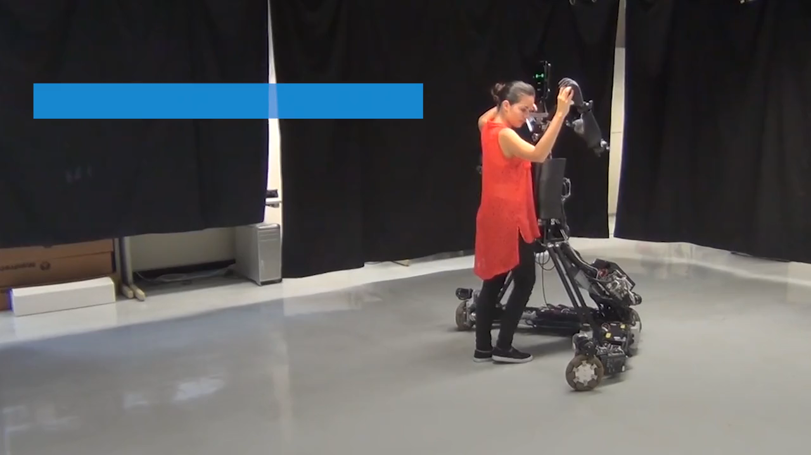

Slide 3
Robotic dance partner (Tohoku Univ)
Fear of technological machines? Haptic AI.
Try physical intimacy, not physical confrontation.
Coolness: tech with function
Success: captures interactions
Domain: tech, robotics

Slide 4
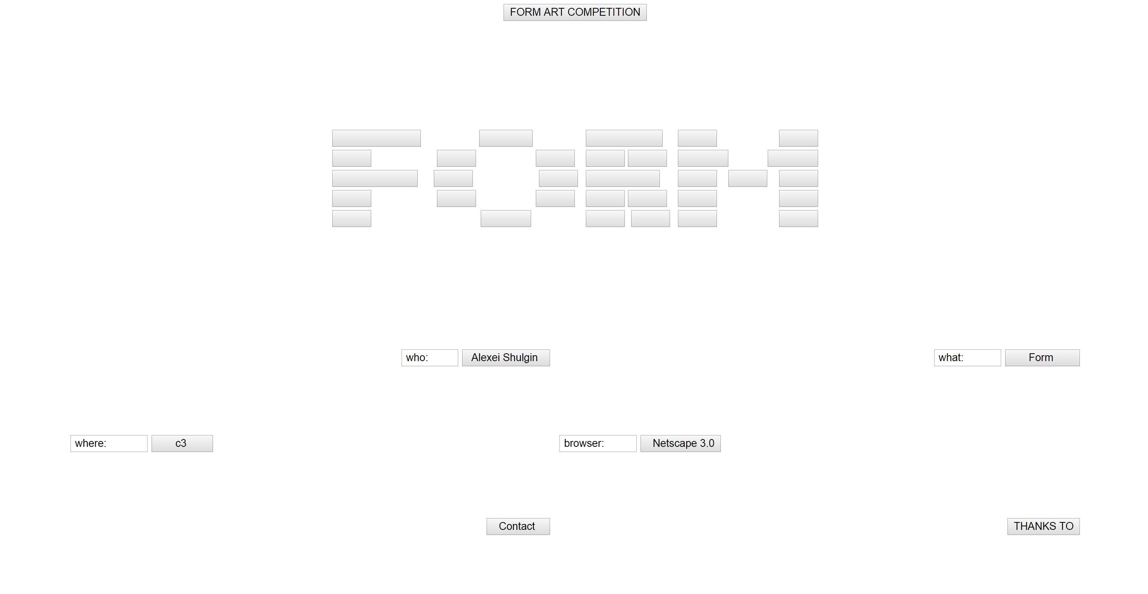

Slide 5
Alexei Shulgin: Form Art webpage
http://archive.rhizome.org/artbase/48528/
The form is the message.
Purposive contradictions.
Coolness: rebellious, parad
Success: cult following
Domain: web art, punk

